Slide 1
Pulmonary and Systemic Circulation
Pulmonary- Carry blood to lungs for gas exchange and return it to the heart
Pump: right side
Systemic-supply oxygen and nutrient rich blood to all organs
Pump: left side

Slide 2
Slide 11.16
The Heart: Cardiac Cycle
Atria contract simultaneously
Atria relax, then ventricles contract
Systole = contraction
Diastole = relaxation
Copyright © 2003 Pearson Education, Inc. publishing as Benjamin Cummings

Slide 3
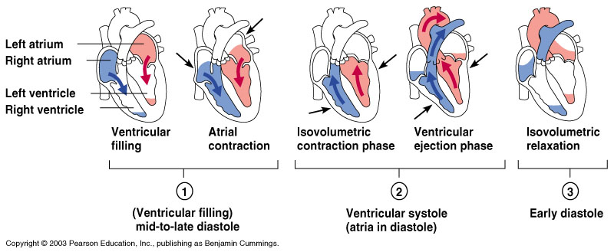
Slide 11.15
Filling of Heart Chambers – the Cardiac Cycle
Figure 11.6
Copyright © 2003 Pearson Education, Inc. publishing as Benjamin Cummings

Slide 4
Slide 11.17
The Heart: Cardiac Cycle
Cardiac cycle – events of one complete heart beat
Mid-to-late diastole – blood flows into ventricles
Ventricular systole – blood pressure builds before ventricle contracts, pushing out blood
Early diastole – atria finish re-filling, ventricular pressure is low
Copyright © 2003 Pearson Education, Inc. publishing as Benjamin Cummings

Slide 5
Slide 11.18
The Heart: Cardiac Output
Cardiac output (CO)
Amount of blood pumped by each side of the heart in one minute
CO = (heart rate [HR]) x (stroke volume [SV])
Stroke volume
Volume of blood pumped by each ventricle in one contraction
Copyright © 2003 Pearson Education, Inc. publishing as Benjamin Cummings

Slide 6
Slide 11.21
The Heart: Regulation of Heart Rate
Increased heart rate
Sympathetic nervous system
Crisis
Hormones
Epinephrine
Thyroxine
Exercise
Decreased blood volume
Copyright © 2003 Pearson Education, Inc. publishing as Benjamin Cummings

Slide 7
Slide 11.22
The Heart: Regulation of Heart Rate
Decreased heart rate
Parasympathetic nervous system
Copyright © 2003 Pearson Education, Inc. publishing as Benjamin Cummings

Slide 8
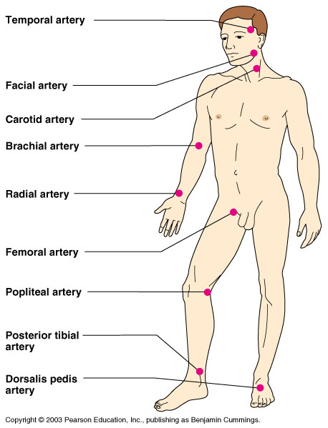
Slide 11.35
Pulse
Pulse – pressure wave of blood
Monitored at “pressure points” where pulse is easily palpated
Figure 11.16
Copyright © 2003 Pearson Education, Inc. publishing as Benjamin Cummings

