Slide 1
Discovery of Tumor Suppressor Genes

Slide 2
Tumor Suppressor Genes
Normal genes whose absence can lead to cancer
If lost or inactivated, their functional absence can allow development of cancer

Slide 3
Tumor Suppressor Genes
Genes come in pairs
Predisposed
born with one mutated gene of a pair
one defected gene will NOT lead to cancer
if normal gene becomes mutated in lifetime—> cancer

Slide 4
Tumor Suppressor Genes
Act like a brake pedal
produce proteins that tell the cell to STOP! dividing
loss of function- cell can divide abnormally and continually

Slide 5
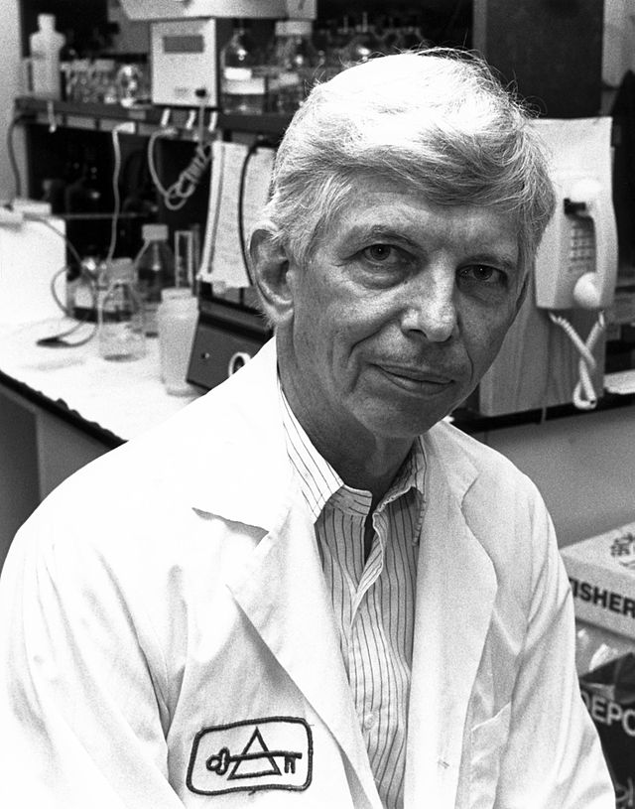
Discovery of Tumor Suppressor Genes
Alfred Knudson and the Two Hit Hypothesis (1971)
“In order for a cell to become cancerous, both of the cell’s tumor suppressor genes must be mutated”

Slide 6
Retinoblastoma- childhood cancer affecting the retinas

Slide 7
Retinoblasts- usually stop growing and dividing in the womb
differentiate into photoreceptors and nerve cells
do not divide
Retinoblastoma (cancer)- cells fail to differentiate
continue dividing
tumors develop
can metastasize

Slide 8
Studied sample of 48 patients. Tabulated results:
 | Bilateral (both eyes) | Unilateral (one eye) | Total
Hereditary | 25%–30% | 10%–15% | 35%–45%
Nonhereditary | 0 | 55%–65% | 55%–65%
Total | 25%–30% | 70%–75% | 100%
Compared age of diagnosis of bilateral and unilateral retinoblastoma

Slide 9
Analysis
If recessive, both genes need to be mutated for cell to be cancerous
If born with one mutated gene, child would need to acquire one additional mutated gene for cancer to form
If born with no mutated genes, child would need to acquire two mutated genes for cancer to form

Slide 10
Would take MUCH longer for child to acquire two mutations rather than one, as seen in the older age of diagnosis for children not born with mutated allele.
diagnosis for bilateral occurred at younger age than unilateral

Slide 11
Conclusion:
Retinoblastoma caused by double mutation on both copies of Rb (tumor suppressor gene)

