Slide 1
Angiogenesis

Slide 2
Angiogenesis
Tumors require access to circulation to grow and survive
obtain oxygen and nutrients, and remove carbon dioxide and metabolic wastes
0.2 mm, the distance that oxygen can diffuse through living masses

Slide 3
Angiogenesis
Tumor cells further than .2 mm away—> necrosis
OR
Angiogenesis!

Slide 4
Experiment!
Implant tumors in ears of lab rabbits
Within DAYS- dense capillary network form on implanted tumor

Slide 5
Angiogenesis
vascular endothelial growth factor- protein that stimulates angiogenesis
VEGF over-expressed
cancers are able to grow

Slide 6
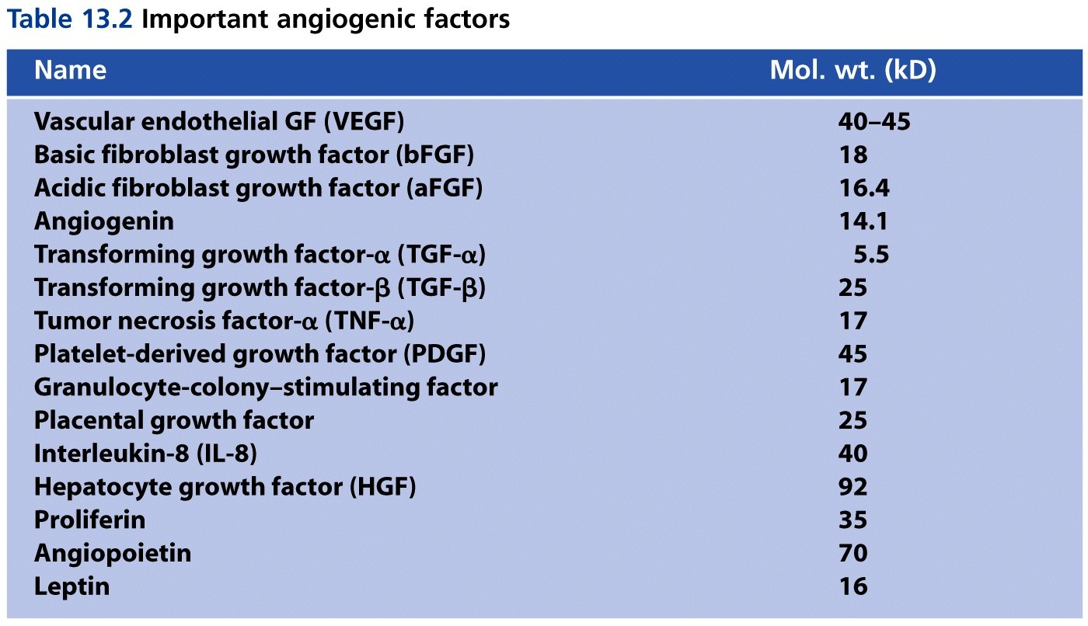
Angiogenic Factors

Slide 7
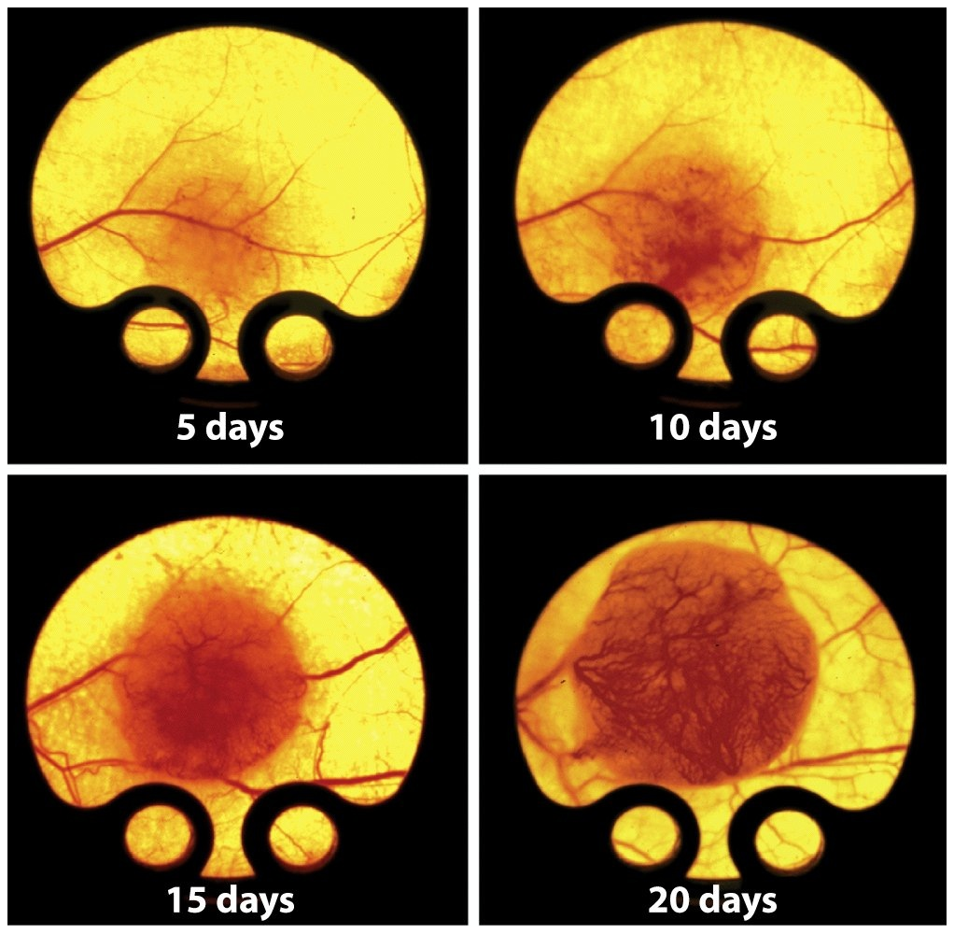
Angiogenesis
Blood vessels grow toward tumor

Slide 8
Angiogenesis
Leaky blood vessels
large capillary diameter
chaotic layout
dead end, circle back and attach to themselves

Slide 9
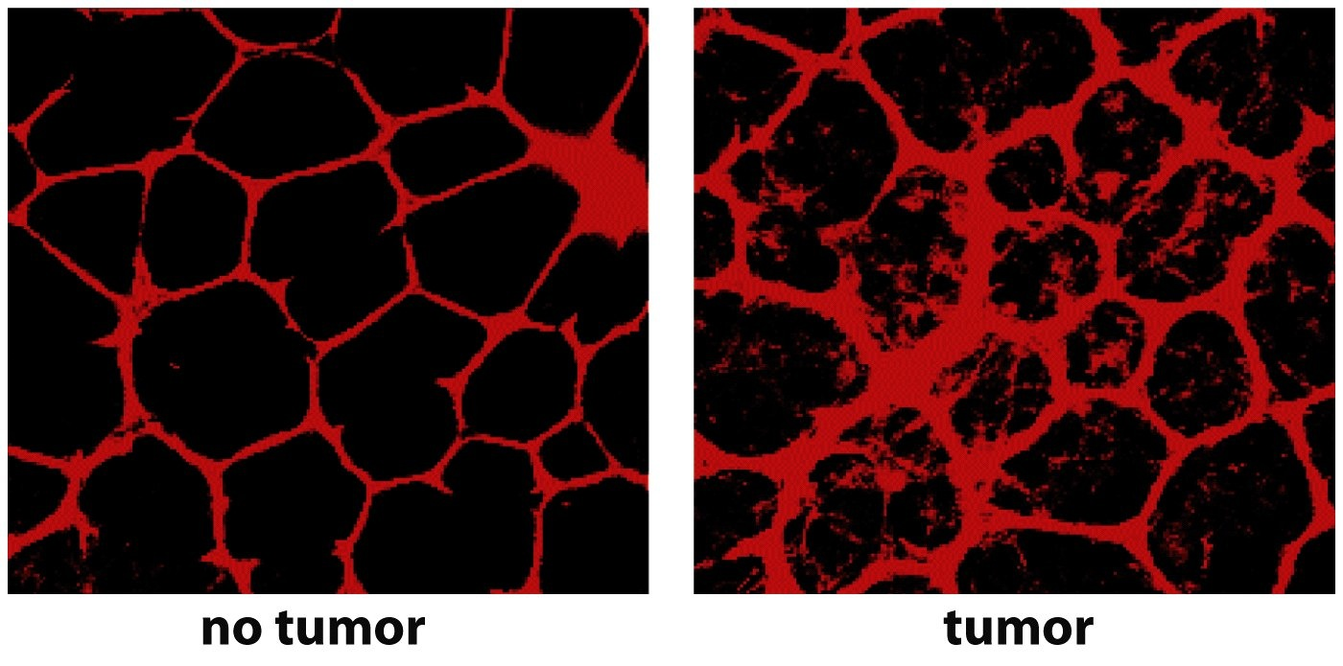
Capillary Leakiness

Slide 10
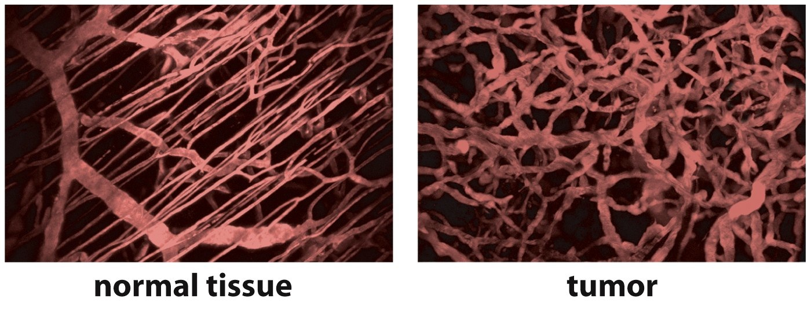
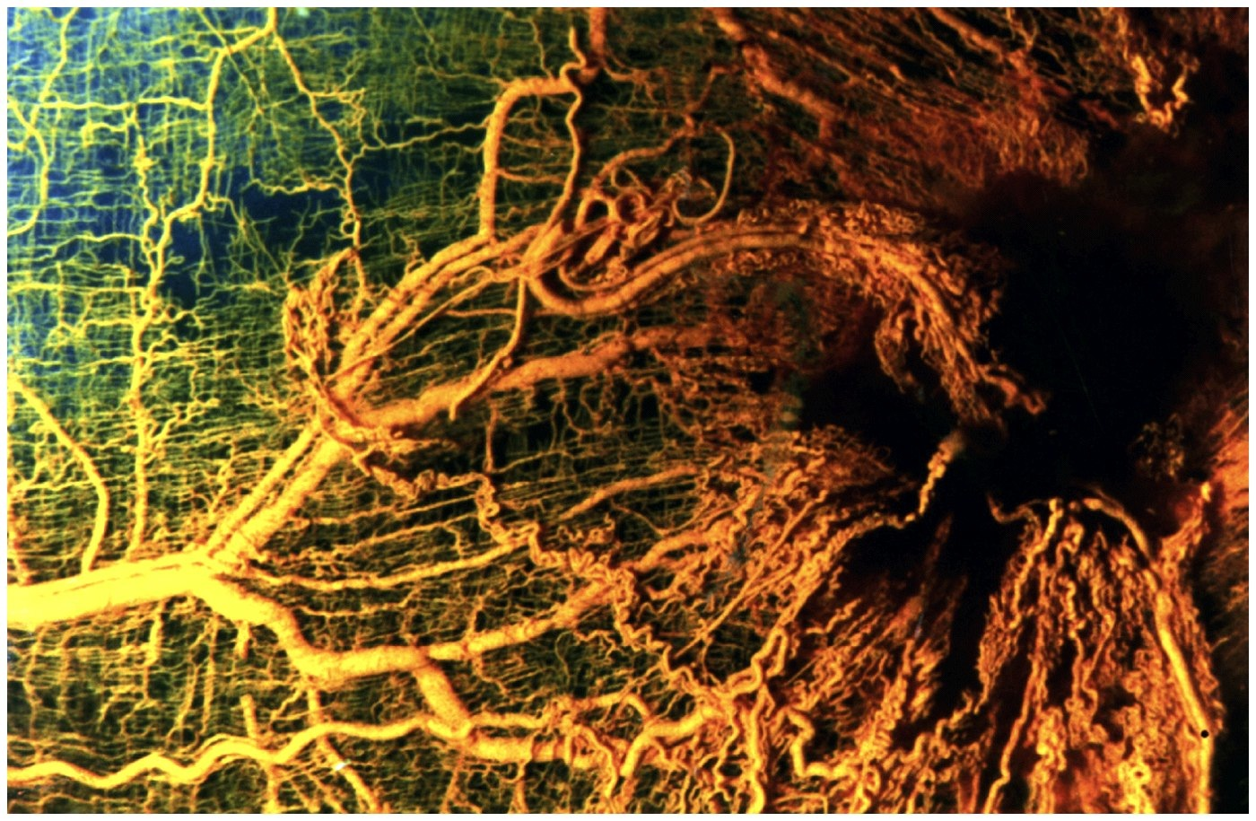

Slide 11
Angiogenesis
Fundamental step in converting cancerous cell from benign to malignant

