Slide 1
Electrocardiograms
Depolarization-cell's membrane becomes positive. Action potential generated. (Na+ and Ca+ into cell)
Repolarization-cell's membrane returns to negative.
Resting membrane potential. (K+ out of cell)

Slide 2
Electrocardiograms
Heart undergoes depolarization and repolarization- electrical currents generated spread throughout heart and body.
Electrical activity generated by the heart measured by electrodes placed on the body.
The recorded tracing is called an electrocardiogram (ECG, or EKG)

Slide 3
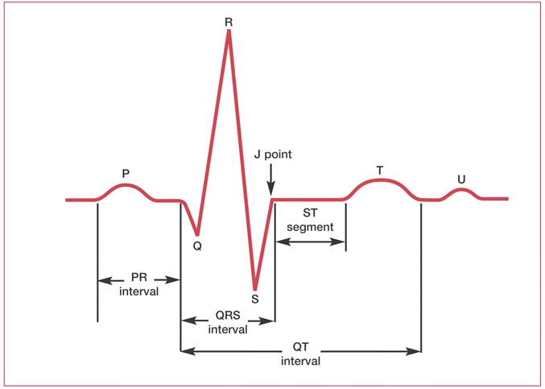
Reading an Electrocardiogram

Slide 4
Reading and Electrocardiogram
P wave
The P wave is a small deflection wave that represents atrial depolarization.
QRS wave complex
The three waves of the QRS complex represent ventricular depolarization.
T wave
T waves represent ventricular repolarization

Slide 5
Reading an Electrocardiogram

Slide 6
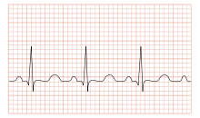
Tachycardia
Heart rate is rapid (over 100 bpm)

Slide 7
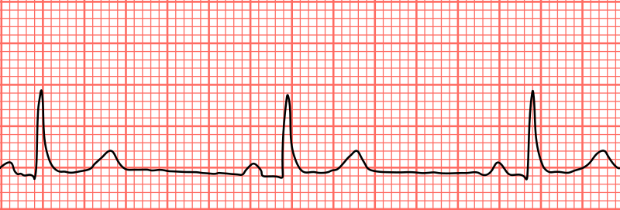
Bradycardia
Heart rate is slower (less than 60 bpm)

Slide 8
Radiographs
Use electromagnetic radiation to see inside the body
conditions of lungs
heart-related lung problems
fluid in the lungs
size and outline of heart
problems with blood vessels
calcium deposits
fractures
pacemaker, defibrillator, catheters

