Slide 1
Hallmarks of Cancer

Slide 2
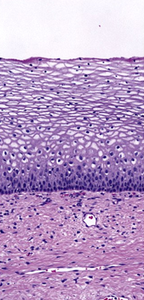
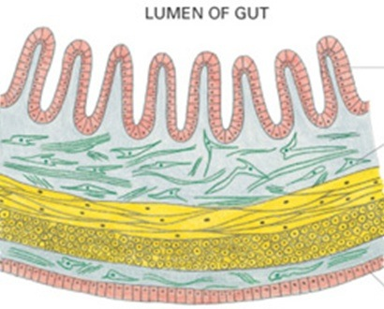
Normal Cells
Cells within a tissue are VERY organized and closely monitored and regulated

Slide 3
Normal Cells
Most have limitations on division
Stem Cells
Most normal cells differentiate
Contact inhibition
Undergo apoptosis

Slide 4
Cancer Cells
Sustain proliferative signaling
“gas pedal stuck on”
Evade growth suppressors
“brakes don’t work”

Slide 5
Cancer Cells
Resist cell death
won't die when body would kill defective cell
Enable replicative immortality
infinite generations of descendants

Slide 6
Cancer Cells
Induce angiogenesis
recruits blood vessels
Activating invasion and metastasis**
migrating and spreading to other parts of the body

Slide 7
Updated Hallmarks (still in review)
Deregulated metabolism
Evade the immune system
Unstable DNA
Inflammation

