Slide 1
Chapter 1 The Human Body: An Orientation
Essentials of Human Anatomy & Physiology
Seventh Edition
Elaine N. Marieb
Slides 1.1 – 1.8
Lecture Slides in PowerPoint edited by James Hook
Copyright © 2003 Pearson Education, Inc. publishing as Benjamin Cummings

Slide 2
Slide 1.1
The Human Body – An Orientation
Anatomy – study of the structure and shape of the body and its parts
Physiology – study of how the body and its parts work or function
Copyright © 2003 Pearson Education, Inc. publishing as Benjamin Cummings

Slide 3
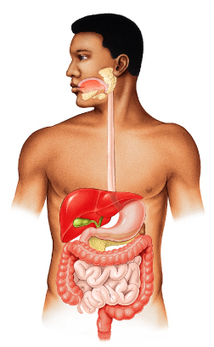
Slide 1.2a
Anatomy – Levels of Study
Gross Anatomy
Large structures
Easily observable
Figure 1.1
Copyright © 2003 Pearson Education, Inc. publishing as Benjamin Cummings

Slide 4
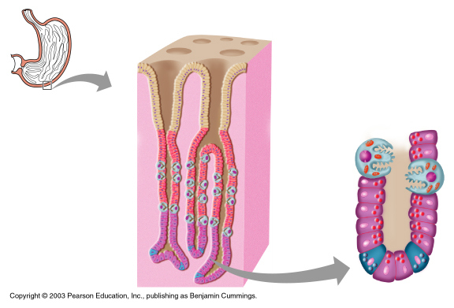
Slide 1.2b
Anatomy – Levels of Study
Microscopic Anatomy
Very small structures
Can only be viewed with a microscope
Figure 14.4
Copyright © 2003 Pearson Education, Inc. publishing as Benjamin Cummings

Slide 5
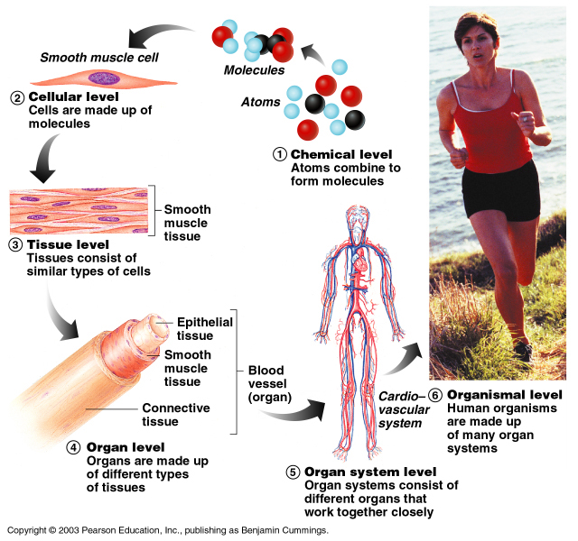
Slide 1.3
Levels of Structural Organization
Figure 1.1
Copyright © 2003 Pearson Education, Inc. publishing as Benjamin Cummings

