Slide 1
Intro to Cancer

Slide 2
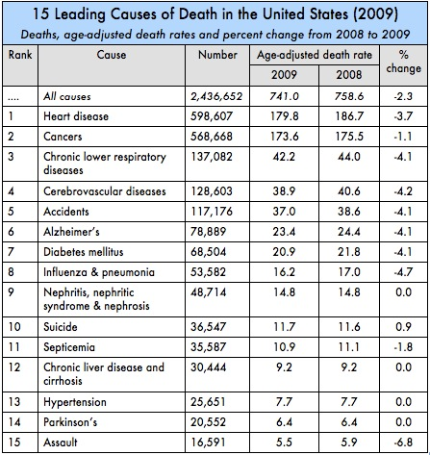
Statistics
Second leading cause of death in US as of 2009]
Rising relative to heart disease
Over 100 different types of cancer

Slide 3
Comparison of 1900 to 2010

Slide 4
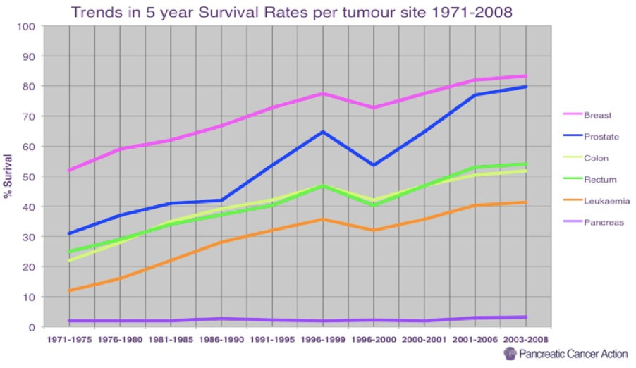
Progress!

Slide 5
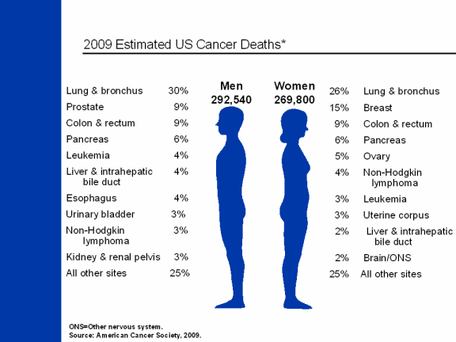
Comparison of Cancer Deaths in Males and Females

Slide 6
Definitions for Cancer
Cancer-disease characterized by the uncontrolled, abnormal growth of cells
Tumor-abnormal mass of tissue resulting from excessive cell division
Malignant-cancerous, will invade adjacent tissues and spread
Benign-not cancerous but could transform

Slide 7
5 Main Categories of Cancer
• Carcinoma - begins in skin or tissues lining or covering internal organs
• Sarcoma - begins in connective or supportive tissue

Slide 8
5 Main Categories of Cancer
• Leukemia - starts in blood-forming tissue (ex. bone marrow)
• Lymphoma and myeloma - begin in the cells of the immune system
• Central nervous system cancers - cancers that begin in the tissues of the brain and spinal cord

