Slide 1
Mutagens and Carcinogens

Slide 2
Carcinogens
substances that cause or promote cancer in humans and animals

Slide 3
Mutagens
any agent that changes the genetic material of an organism leading to increased frequency of mutations
Usually also carcinogens

Slide 4
Known Human Carcinogens
Alcoholic beverages
Arsenic
Artificial sweeteners
Asbestos
Coal
Estrogen-progestogen oral contraceptives

Slide 5
Known Human Carcinogens
Formaldehyde
Radon
Tobacco
UV radiation

Slide 6
Surprising Carcinogens
Grilled meat
Free radicals
Fiddleheads

Slide 7
Risk Factors
Lifestyle
diet and exercise
tobacco and alcohol use
tanning
Ethnicity
Age
Sex
Occupation

Slide 8
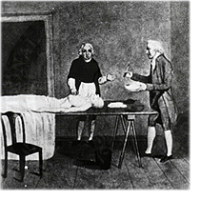
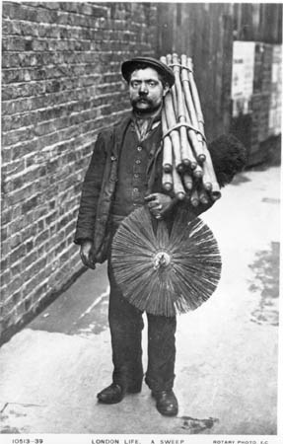
The first association between occupation and cancer
Percivall Pott found that chimney sweeps show substantially higher rates of skin cancer
Notes:
The idea that environmental factors are involved in cancer came in the late 18th century. A British surgeon, Percival Pott, realized that there is a high incidence of skin cancer cases specifically in men that used to work as chimney sweeps in their youth.

Slide 9
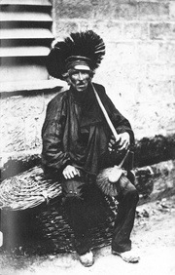
British chimney sweeps didn’t do anything about it
Danish chimney sweeps : a daily bath after work
Result: significantly lower rates of skin cancer amongst Danish versus British chimney sweeps, even a century later
Notes:
Within 3 years, the Danish sweepers guild urged all its members to take a daily bath after work. The result- significantly lower rates of skin cancer amongst Danish chimney sweeps, compared with Britain, even a century later.

Slide 10
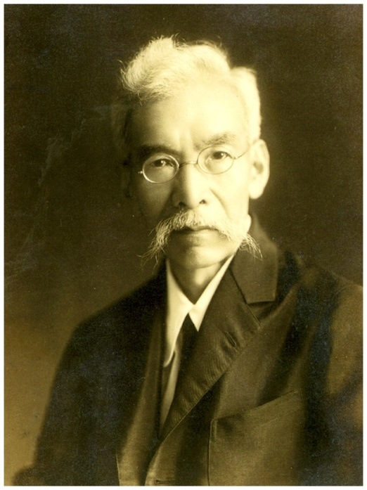
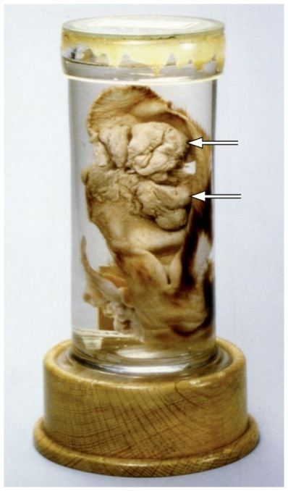
Yamagiwa took it one step further
Coal tar condensates induced skin carcinoma in rabbits
Chemicals can directly induce cancer
Cancer can be studied in the lab
Yamagiwa
Figure 2.21b The Biology of Cancer (© Garland Science 2007)
Notes:
Yamagiwa took one step further and tried different materials he suspected might be involved in cancer. He “painted” coal tar condensates on localized areas of the skin in rabbits and found that they induced carcinomas. These experiments represented a stunning advance:
Chemicals can directly cause cancer.
Cancer can be studied in a lab, with model organisms, not waiting for a tumor to develop and then analyze it.

