Slide 1
Mutations and Genetic Abnormalities

Slide 2
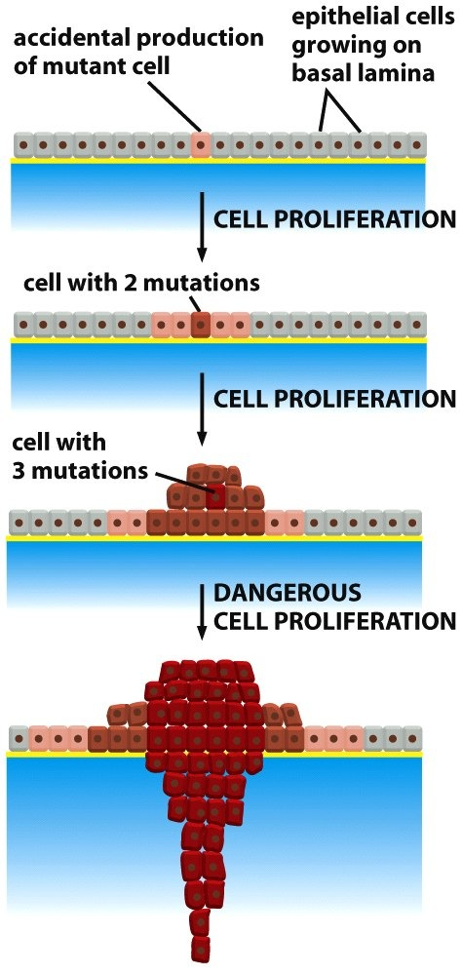
Mutations
Often starts with a single mutation
One mutation is NOT enough to form cancer
Continuous mutations are dangerous

Slide 3
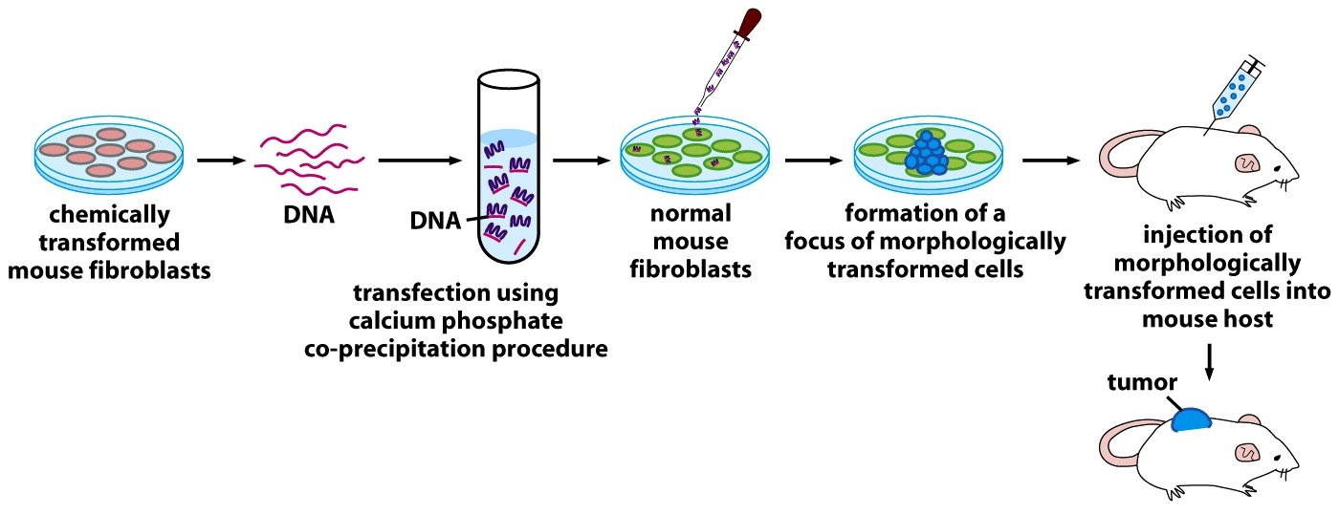
Evidence that DNA mutations cause cancer

Slide 4
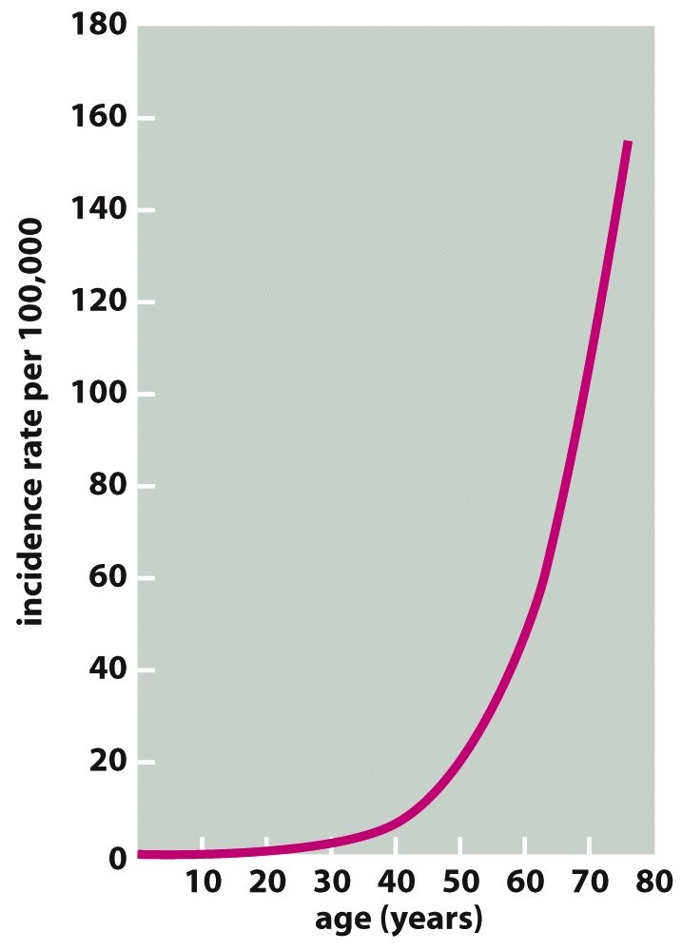
Mutations
Cancer is a MULTI-STEP process
Reflected in correlation between age and incidence of cancers

Slide 5
Genes Affected by Mutation
Oncogenes-turn healthy cell into cancerous cell when activated
acquired mutations, not inherited

Slide 6
Genes Affected by Mutation
Tumor Suppressor Genes- protective measure against cancer cells.
turned off, no protection
most are acquired

Slide 7
Genes Affected by Mutation
DNA repair genes- fix mistakes when DNA is copied
mutated-no proofreading
can be inherited

