Slide 1
Walls of alimentary canal
Mucosa-innermost layer, lines cavity(lumen)
Submucosa-beneath mucosa, contains blood vessels, nerve endings, lymph nodes, and lymph vessels
Muscularis Externa- muscle wall made up of two layers of smooth muscle
Serosa-outermost layer of wall

Slide 2
Walls of Alimentary Canal

Slide 3
Slide 14.21
Small Intestine
The body’s major digestive organ
Site of nutrient absorption into the blood
Muscular tube extending from the pyloric sphincter to the ileocecal valve
Copyright © 2003 Pearson Education, Inc. publishing as Benjamin Cummings

Slide 4
Slide 14.22
Subdivisions of the Small Intestine
Duodenum
Attached to the stomach
Curves around the head of the pancreas
Jejunum
Attaches anteriorly to the duodenum
Ileum
Extends from jejunum to large intestine
Copyright © 2003 Pearson Education, Inc. publishing as Benjamin Cummings

Slide 5
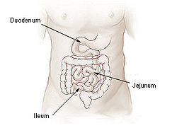

Slide 6
Slide 14.23a
Chemical Digestion in the Small Intestine
Source of enzymes that are mixed with chyme
Intestinal cells
Pancreas
Bile enters from the gall bladder
Copyright © 2003 Pearson Education, Inc. publishing as Benjamin Cummings

Slide 7
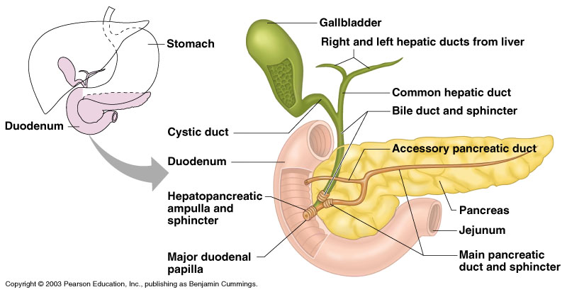
Slide 14.23b
Chemical Digestion in the Small Intestine
Figure 14.6
Copyright © 2003 Pearson Education, Inc. publishing as Benjamin Cummings

Slide 8
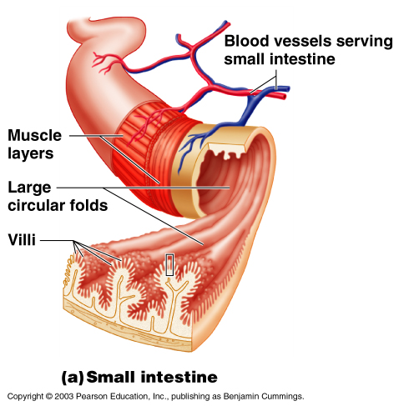
Slide 14.24
Villi of the Small Intestine
Fingerlike structures formed by the mucosa
Give the small intestine more surface area
Figure 14.7a
Copyright © 2003 Pearson Education, Inc. publishing as Benjamin Cummings

Slide 9
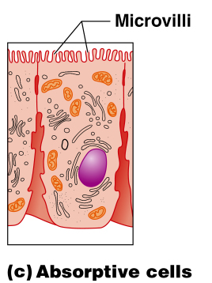
Slide 14.25
Microvilli of the Small Intestine
Small projections of the plasma membrane
Found on absorptive cells
Figure 14.7c
Copyright © 2003 Pearson Education, Inc. publishing as Benjamin Cummings

Slide 10
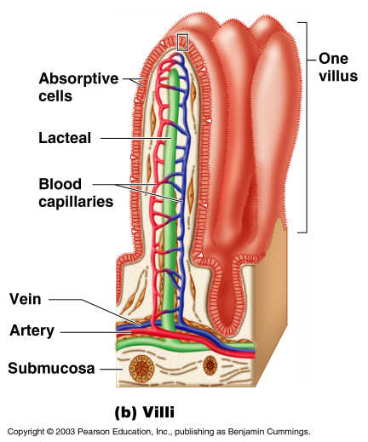
Slide 14.26
Structures Involved in Absorption of Nutrients
Absorptive cells
Blood capillaries
Lacteals (specialized lymphatic capillaries)
Figure 14.7b
Copyright © 2003 Pearson Education, Inc. publishing as Benjamin Cummings

Slide 11
Slide 14.27
Folds of the Small Intestine
Called circular folds or plicae circulares
The submucosa has Peyer’s patches (collections of lymphatic tissue)
Copyright © 2003 Pearson Education, Inc. publishing as Benjamin Cummings

Slide 12
END

Slide 13
Slide 14.29
Functions of the Large Intestine
Absorption of water
Eliminates indigestible food from the body as feces
Does not participate in digestion of food
Goblet cells produce mucus to act as a lubricant
Copyright © 2003 Pearson Education, Inc. publishing as Benjamin Cummings

Slide 14
Slide 14.30a
Structures of the Large Intestine
Cecum – saclike first part of the large intestine
Appendix
Accumulation of lymphatic tissue that sometimes becomes inflamed (appendicitis)
Hangs from the cecum
Copyright © 2003 Pearson Education, Inc. publishing as Benjamin Cummings

Slide 15
Slide 14.30b
Structures of the Large Intestine
Colon
Ascending
Transverse
Descending
S-shaped sigmoidal
Rectum
Anus – external body opening
Walls are formed into pocketlike sacs called haustra
Copyright © 2003 Pearson Education, Inc. publishing as Benjamin Cummings

Slide 16
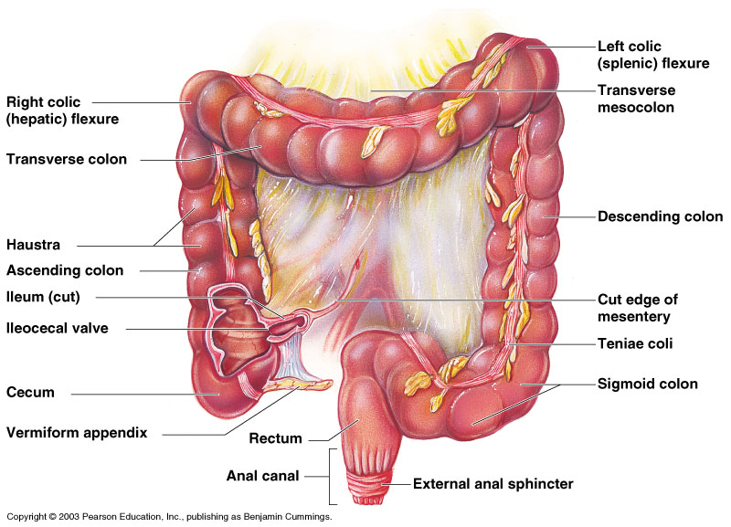
Slide 14.28
Large Intestine
Figure 14.8
Copyright © 2003 Pearson Education, Inc. publishing as Benjamin Cummings

